Slide 1
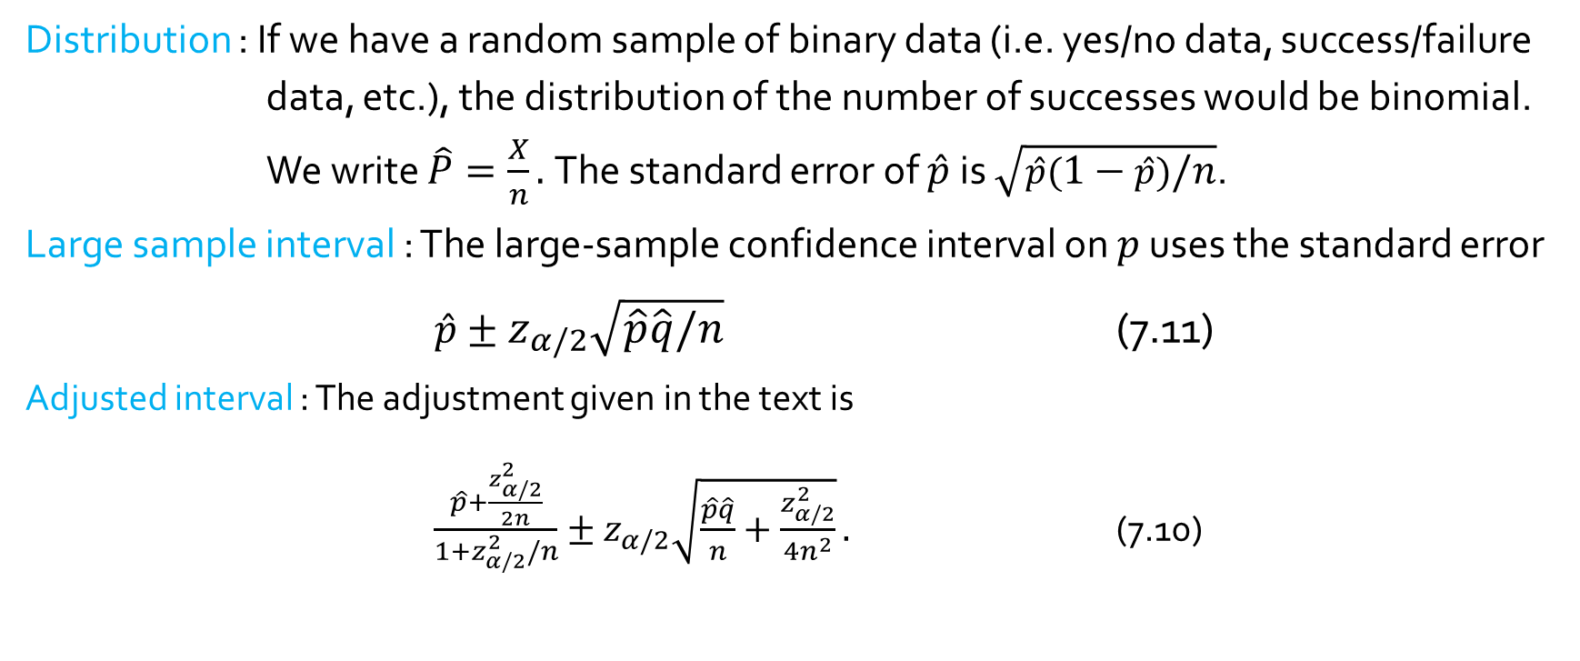
Confidence intervals on proportions
Distribution : If we have a random sample of binary data (i.e. yes/no data, success/failure data, etc.), the distribution of the number of successes would be binomial. We write $\hat{P}=\frac{X}{n}.$The standard error of $\hat{p}$is $\sqrt{\hat{p}(1−\hat{p})/n}$.
Large sample interval : The large-sample confidence interval on $p$ uses the standard error
$\hat{p}±z_{α/2}\sqrt{\hat{p}\hat{q}/n}$ (7.11)
Adjusted interval : The adjustment given in the text is
$\frac{\hat{p}+\frac{z_{α/2}^{2}}{2n}}{1+z_{α/2}^{2}/n}±z_{α/2}\sqrt{\frac{\hat{p}\hat{q}}{n}+\frac{z_{α/2}^{2}}{4n^{2}}}.$ (7.10)

Slide 2
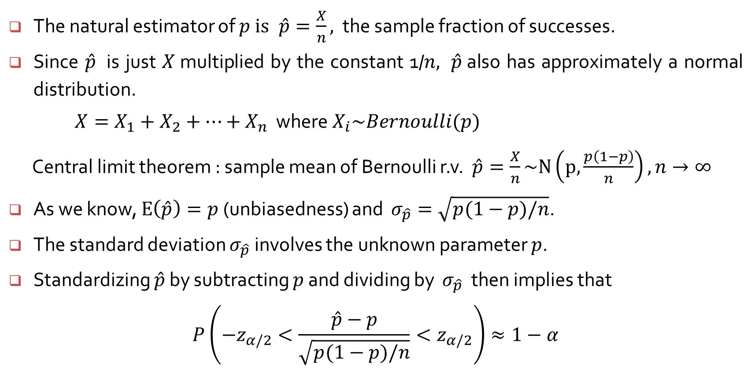
A Confidence interval for a population proportions
The natural estimator of $p$ is$\hat{p}=\frac{X}{n},$ the sample fraction of successes.
Since $\hat{p}$ is just $X$multiplied by the constant 1/$n,$ $\hat{p}$also has approximately a normal distribution.
$X=X_{1}+X_{2}+⋯+X_{n}$ where $X_{i}\sim Bernoulli(p)$
Central limit theorem : sample mean of Bernoulli r.v. $\hat{p}=\frac{X}{n}\sim N\left(p, \frac{p\left(1−p\right)}{n}\right), n→∞$
As we know, $E\left(\hat{p}\right)=p$(unbiasedness) and $σ_{\hat{p}}=\sqrt{p(1−p)/n}$.
The standard deviation $σ_{\hat{p}}$involves the unknown parameter $p$.
Standardizing $\hat{p}$ by subtracting $p$ and dividing by $σ_{\hat{p}}$ then implies that
$$P\left(−z_{α/2}<\frac{\hat{p}−p}{\sqrt{p(1−p)/n}}<z_{α/2}\right)≈1−α$$

Slide 3
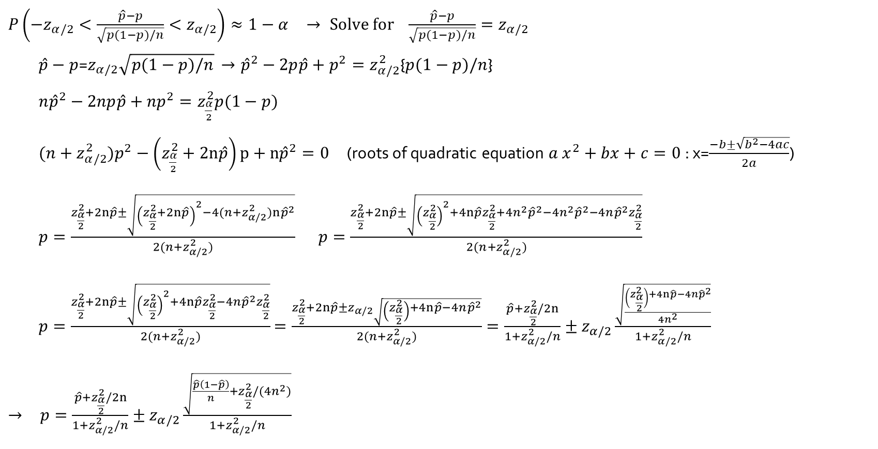
A Confidence interval for a population proportions
$P\left(−z_{α/2}<\frac{\hat{p}−p}{\sqrt{p(1−p)/n}}<z_{α/2}\right)≈1−α$ $→ Solve for \frac{\hat{p}−p}{\sqrt{p(1−p)/n}}=z_{α/2}$
$\hat{p}−p$=$z_{α/2}\sqrt{p(1−p)/n}$ $→$ ${\hat{p}}^{2}−2p\hat{p}+p^{2}=z_{α/2}^{2}${$p(1−p)/n$}
${n\hat{p}}^{2}−2np\hat{p}+{np}^{2}=z_{\frac{α}{2}}^{2}p(1−p)$
${(n+z}_{α/2}^{2})p^{2}−\left(z_{\frac{α}{2}}^{2}+2n\hat{p}\right)p+n{\hat{p}}^{2}=0$ (roots of quadratic equation $a x^{2}+bx+c=0$: x=$\frac{−b±\sqrt{b^{2}−4ac}}{2a}$)
$p=\frac{z_{\frac{α}{2}}^{2}+2n\hat{p}±\sqrt{{\left(z_{\frac{α}{2}}^{2}+2n\hat{p}\right)}^{2}−4{(n+z}_{α/2}^{2})n{\hat{p}}^{2}}}{{2(n+z}_{α/2}^{2})}$ $p=\frac{z_{\frac{α}{2}}^{2}+2n\hat{p}±\sqrt{{\left(z_{\frac{α}{2}}^{2}\right)}^{2}+4n\hat{p}z_{\frac{α}{2}}^{2}+4n^{2}{\hat{p}}^{2}−4n^{2}{\hat{p}}^{2}−4n{\hat{p}}^{2}z_{\frac{α}{2}}^{2}}}{{2(n+z}_{α/2}^{2})}$
$p=\frac{z_{\frac{α}{2}}^{2}+2n\hat{p}±\sqrt{{\left(z_{\frac{α}{2}}^{2}\right)}^{2}+4n\hat{p}z_{\frac{α}{2}}^{2}−4n{\hat{p}}^{2}z_{\frac{α}{2}}^{2}}}{{2(n+z}_{α/2}^{2})}$ $=\frac{z_{\frac{α}{2}}^{2}+2n\hat{p}±z_{α/2}\sqrt{\left(z_{\frac{α}{2}}^{2}\right)+4n\hat{p}−4n{\hat{p}}^{2}}}{{2(n+z}_{α/2}^{2})}=\frac{{\hat{p}+z}_{\frac{α}{2}}^{2}/2n}{{1+z}_{α/2}^{2}/n}±z_{α/2}\frac{\sqrt{\frac{\left(z_{\frac{α}{2}}^{2}\right)+4n\hat{p}−4n{\hat{p}}^{2}}{4n^{2}}}}{{1+z}_{α/2}^{2}/n}$
$→$ $p=\frac{{\hat{p}+z}_{\frac{α}{2}}^{2}/2n}{{1+z}_{α/2}^{2}/n}±z_{α/2}\frac{\sqrt{\frac{\hat{p}\left(1−\hat{p}\right)}{n}+z_{\frac{α}{2}}^{2}/(4n^{2})}}{{1+z}_{α/2}^{2}/n}$

Slide 4
Confidence intervals on proportions : Example 7.8
An article in J. Testing and The Eval. had 16 successes in 48 trials.
The 95% confidence intervals from the text are (0.217, 0.474) (with correction by eqn (7.10)) and
(0.200, 0.466) (without correction by eqn (7.11))
> prop.test(16, 48)
1-sample proportions test with continuity correction
data: 16 out of 48, null probability 0.5
X-squared = 4.6875, df = 1, p-value = 0.03038
alternative hypothesis: true p is not equal to 0.5
95 percent confidence interval:
0.2080794 0.4851357 0.2080794 < (0.217 < 0.474) < 0.4851357
sample estimates: 0.2080794 < (0.200 < 0.466) < 0.4851357
p
0.3333333

Slide 5
Confidence intervals on proportions : Example 7.8
> binom.test(16, 48)
Exact binomial test
data: 16 and 48
number of successes = 16, number of trials = 48, p-value = 0.0293
alternative hypothesis: true probability of success is not equal to 0.5
95 percent confidence interval:
0.2039597 0.4841083 0.2039597 < (0.217 < 0.474) < 0.4841083
sample estimates: 0.2039597 < (0.200 < 0.466) < 0.4841083
probability of success
0.3333333

